Slide 1
Amphibians and Reptiles
Cool Tetrapods!

Slide 2
Instructions
You will work with your partner
You will complete the plan/outline for the Claim-Evidence-Reasoning Prompt for Amphibians and Reptiles
You will then read about an assigned group of Amphibians or Reptiles to create a two slide presentation about the group.
References allowed include your notes and references posted by Mrs. Gallivan in Compass or handed out in class.

Slide 3
Model CER
Claim: Fish are excellent swimmers and successfully survive an entirely aquatic life.
Evidence | fins | gills | scales | shape
Reasoning | for propulsion and balance in water; enables hunting and escaping predators | efficiently obtain oxygen from water needed for making energy | waterproofing to maintain proper water-salt balance | generally streamlined for movement in water to assist with hunting and escaping predators

Slide 4
Claim: Amphibians must lead a double life, which restricts members to moist habitats.
Evidence | What features do amphibians possess that support the claim?
 | Soft squishy eggs Gills as a child Develop lungs as an adult Webbed feet 4 legs Limited amount of oxygen
Reasoning | Connect the evidence to the claim. How do the features allow for survival?
 | They start as an egg in water to survive. If on land, the egg would stick to the ground. Amphibians have gills when they come out of their egg as a tadpole they are still limited to water. As they get older they gain lungs, being able to leave the water source that they are in. This allows the to go back into the water to lay eggs and go anywhere without water which allows them to find food. Their 4 sturdy legs help them move on land quickly and their webbed feet is to help them move in the water When out of water there is a limited amount of oxygen when they are still developing and fully developed.

Slide 5
Part of Chart | Criteria | Point Value
Evidence Scientific evidence that supports the claim. Specific adaptations (features) are described and discussed. The adaptations chosen support the topic statement. 4 specific items of evidence needed | Provides evidence to support the claim that is Appropriate (Scientific information from notes, textbook, and class discussions only) | 2 points per feature
 | Provides evidence to support the claim that is Sufficient (Enough features to support the claim- 4 to 5 specific adaptations) | 1 point per feature (4 points total)
Reasoning A justification that connects the evidence to the claim. It shows how and why the features listed help the animal survive the conditions stated in the claim. | Explanation provides reasoning that is Clear (it is clear that you know how the feature helps survival and link to the theme) | 5 points
 | Explanation provides reasoning that is Connected (Explains why the evidence is important or why it is relevant to survival) | 5 points
 | Explanation provides reasoning that is Integrated (Links the evidence to the theme) | 5 points
Spelling: Spelling errors are limited and do not infer with message and flow |  | 3 points
30 points total

Slide 6
Claim: Reptiles can survive without moist habitats and were the first vertebrates to “rule” dry climates.
Evidence | What features do reptiles possess that support the claim?
 | Clawed toes Developed lungs Most lay hard shells Efficient Kidneys 3 and 4 chambered hearts Scales
Reasoning | Connect the evidence to the claim. How do the features allow for survival?
 | Clawed toes give them a way to walk on land and grip on to different surfaces. Clawed toes can also pierce right through other reptiles prey Their well-developed lungs help them to breathe and survive on land, not just water Most reptiles lay hard eggs for their baby to stay absorb the nutrients while they are developing. This allows them to lay eggs out of water. Efficient Kidneys - are good at maintaining water balance Most reptiles have 3 chambered hearts but crocodilians have a 4 chambered heart which allows them to cycle their blood which allows them to hold their breath for longer. A 4 chambered heart is also more efficient than a 3 chambered heart. Scales - allow them to give a hardened skin like shell for protection so no animal can pierce through its skin.

Slide 7
Part of Chart | Criteria | Point Value
Evidence Scientific evidence that supports the claim. Specific adaptations (features) are described and discussed. The adaptations chosen support the topic statement. 4 specific items of evidence needed | Provides evidence to support the claim that is Appropriate (Scientific information from notes, textbook, and class discussions only) | 2 points per feature
 | Provides evidence to support the claim that is Sufficient (Enough features to support the claim- 4 to 5 specific adaptations) | 1 point per feature (4 points total)
Reasoning A justification that connects the evidence to the claim. It shows how and why the features listed help the animal survive the conditions stated in the claim. | Explanation provides reasoning that is Clear (it is clear that you know how the feature helps survival and link to the theme) | 5 points
 | Explanation provides reasoning that is Connected (Explains why the evidence is important or why it is relevant to survival) | 5 points
 | Explanation provides reasoning that is Integrated (Links the evidence to the theme) | 5 points
Spelling: Spelling errors are limited and do not infer with message and flow |  | 3 points
30 points total

Slide 8
Class: Reptiles
Group: Crocodilians
Unique Features
Some give live birth
Cover their eggs in sand and put them in a hole.
4 chambered heart.
Very effective at breathing
Great swimmers
Run really fast
The Group has the following Features of the Class:
Vertebrate Chordate
Water tight skin & scales
Clawed toes Ectothermic
Endothermic
Developed Lungs
Scales
Amniote
Amniotic egg
Molt to grow
Efficient kidneys

Slide 9
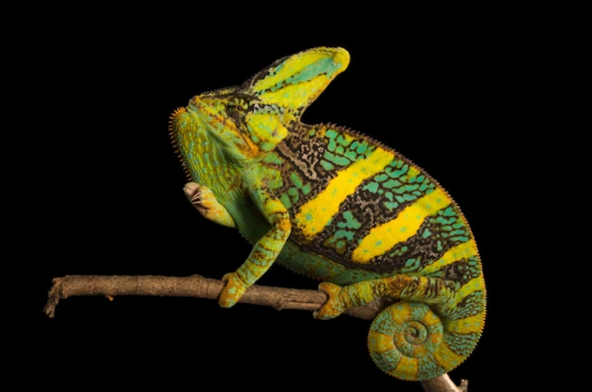
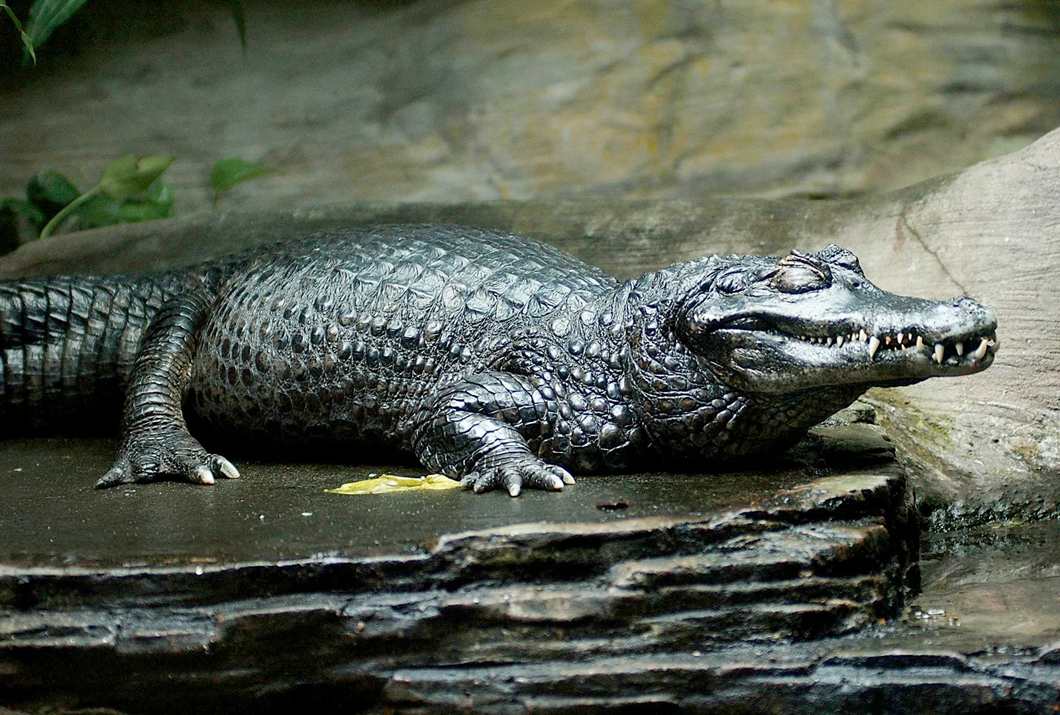
Class: Reptile
Group: Crocodilians
Picture
Veiled Chameleon (Chamaeleo calyptratus)
Black Caiman (Melanosuchus niger)
https://www.nationalgeographic.com/animals/reptiles/facts/veiled-chameleonPicture
https://www.britannica.com/story/7-crocodilian-species-that-are-dangerous-to-humans

Slide 10
Rubric
2 points: thorough and accurate; 1 point: completed; 0 points- missing
Scientific class name included on Info slide | Your score
Scientific class included on picture slide
Scientific Group name included on info slide
Scientific group name included on picture slide
At least 5 shared features listed
Shared features are accurate
At least 4 unique features listed
Unique features are accurate
Picture 1 fits content
Picture 2 fits content | 80

Slide 11
Example

Slide 12
Reptilians The Tuataras
Unique Features
Nocturnal
No external ears
Prefer cooler temperatures
"Third eye" on head to sense season or time of day (parietal eye)
Only live in New Zealand
The Group has the following Features of the Class:
Vertebrate Chordate
Amniotes
Water tight skin with scales
Lay amniotic eggs
Internal fertilization
Well developed lungs
Ectothermic
Clawed toes
Efficient kidneys to maintain water-salt balance
Three-chambered heart
Molt to grow

Slide 13
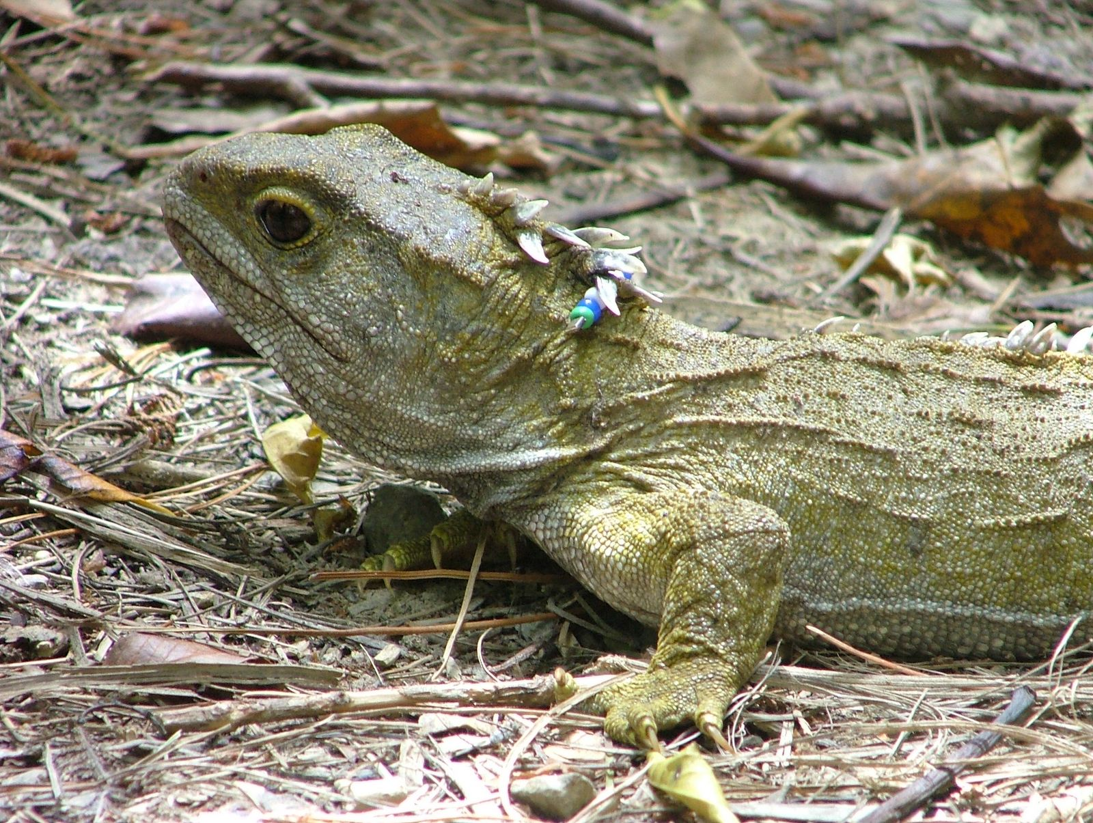
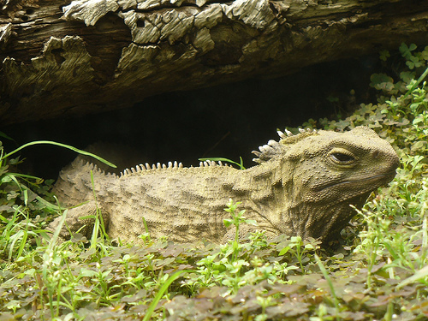
Reptilians The Tuataras

